Slide 1

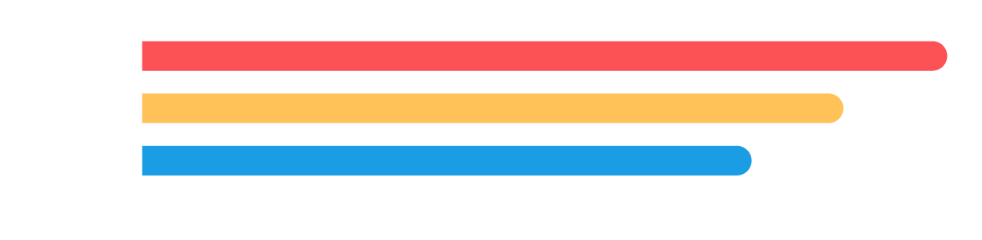
Reports and Dashboards in Salesforce
Independent Project: Use Salesforce to Create Reports and Dashboards
[Sitharthan V]

Slide 2
Project
Overview
1
Task 1: Create a Tabular Report
2
Task 2: Create a Summary Report
3
Task 3: Create a Matrix Report
4
Task 4: Business Case Analysis

Slide 3
Project
Overview
5
Task 5: Create a New Report
6
Task 6: Create Report Charts
7
Task 7: Create a Dashboard

Slide 4
Task 1: Create a Tabular Report
On the following slide, insert a screenshot of the tabular report you just created and ran.

Slide 5
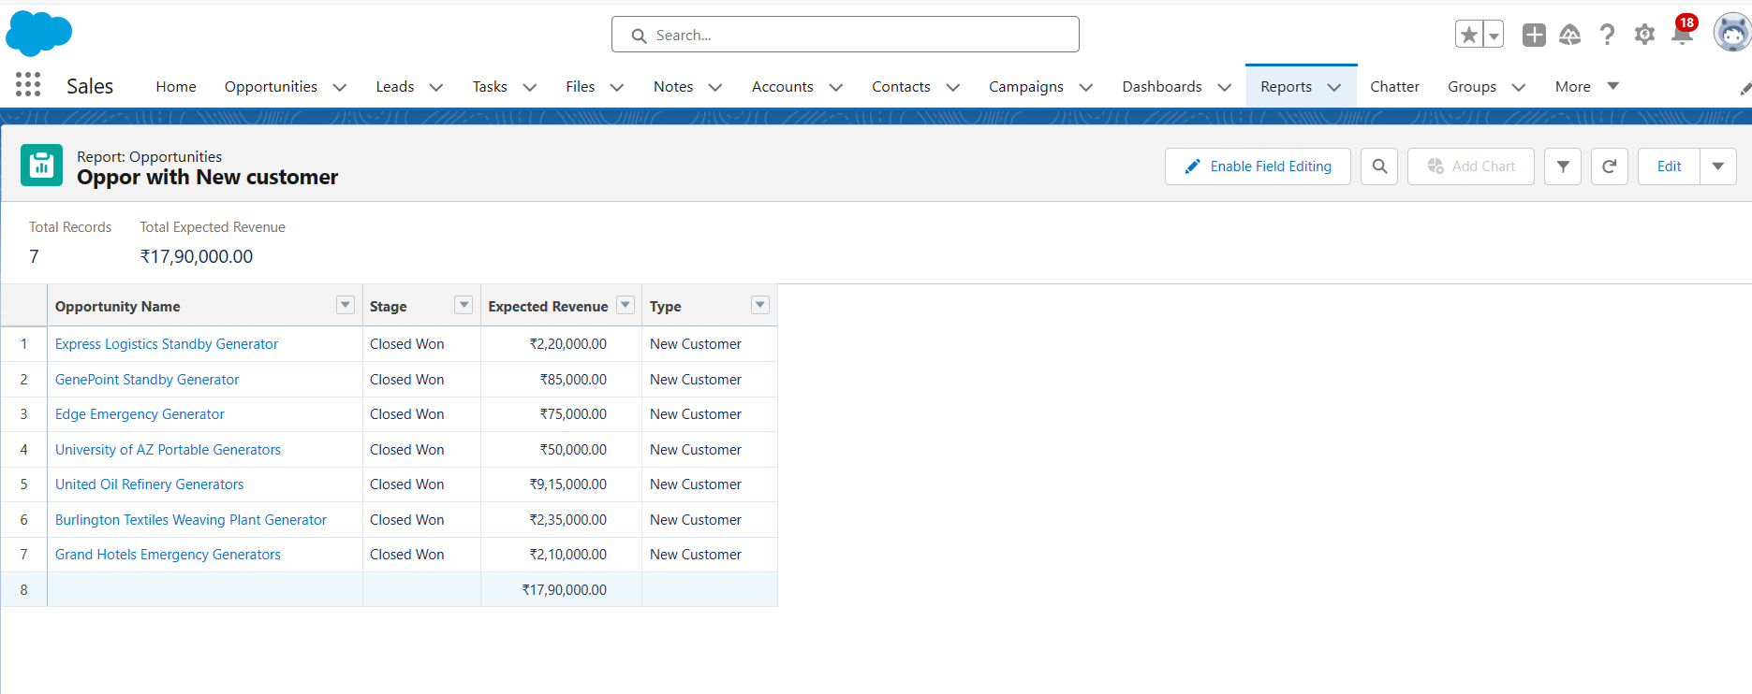
Task 1: Create a Tabular Report

Slide 6
Task 2: Create a Summary Report
On the following slide, insert a screenshot of the summary report you just created and ran.

Slide 7
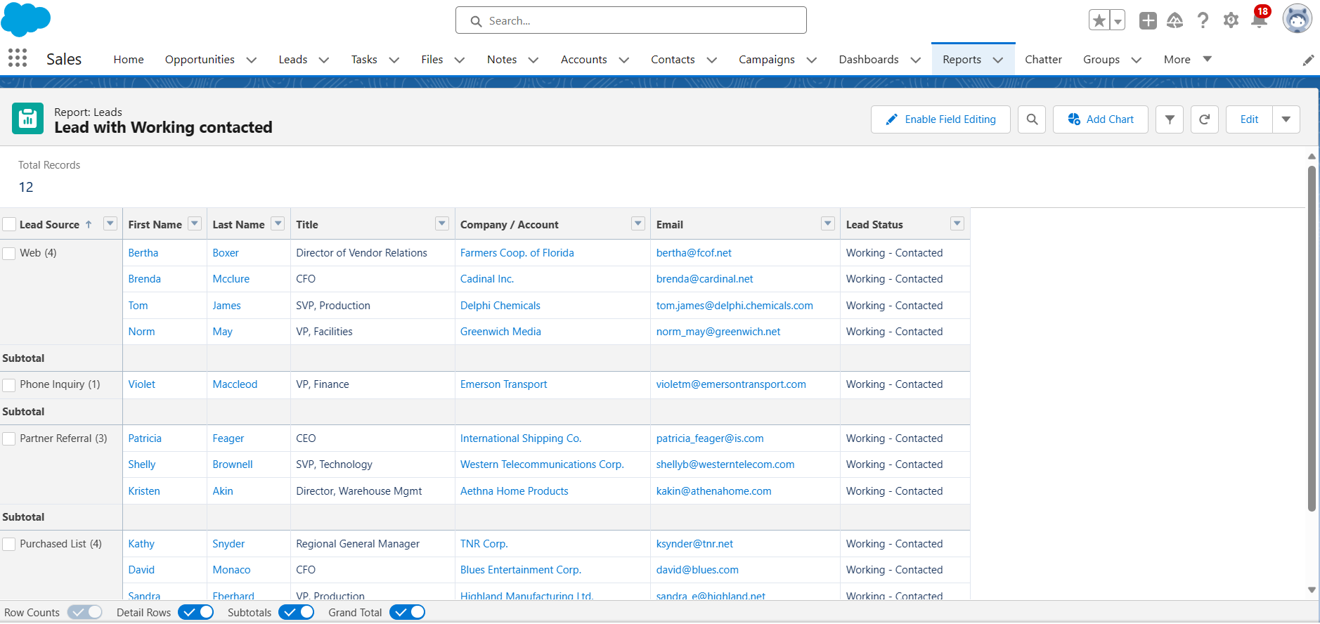
Task 2: Create a Summary Report

Slide 8
Task 3: Create a Matrix Report
On the following slide, insert a screenshot of the matrix report you just created and ran.

Slide 9
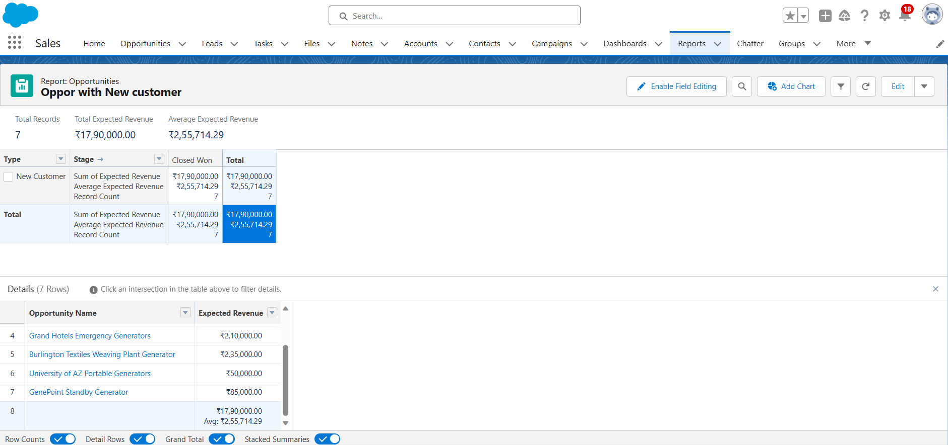
Task 3: Create a Matrix Report

Slide 10
Task 4: Business Case Analysis
In a short paragraph on the following slide, describe how using various reports in Salesforce would help SimplySocial make data-driven decisions. In your description, include:
The overall purpose of reports, report filters, and report types
The major steps you took to create various reports
How SimplySocial would benefit from using reports

Slide 11
Task 4: Business Case Analysis
Reports in Salesforce are used to display and summarize data from standard and custom objects within your organization.
The primary purpose of reports is to provide a way for users to access and view data in a structured, organized, and presentable format.
Reports allow you to see trends, make informed decisions, and monitor the performance of various aspects of your business
Tabular Reports: Present data in a simple table format.
Summary Reports: Summarize data and group it into categories, displaying subtotals and totals.
Matrix Reports: Display data in a grid format with both row and column groupings.
Joined Reports: Combine multiple report types in a single report.
Report filters are used to narrow down the data displayed in a report to focus on specific criteria or subsets of data. They allow users to refine the information they see in the report by specifying conditions that must be met. Report filters help users answer specific questions or perform in-depth analyses.

Slide 12
Task 5: Create a New Report
On the following slide, insert a screenshot of the new report you just created and ran.

Slide 13
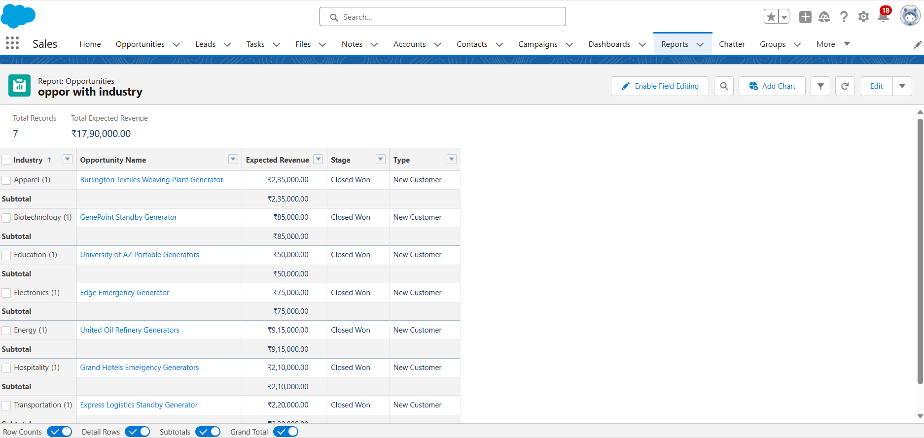
Task 5: Create a New Report

Slide 14
Task 6: Create Report Charts
On the following slides, insert screenshots of the charts you just created:
Step 1: All opportunities of all time that have been “Closed — Won” among new customers, with opportunities grouped by industry
Step 2: All leads of all time that are currently “Working — Contacted”, grouped by lead source
Step 3: Expected revenue of all time for open opportunities where probability is >30%

Slide 15
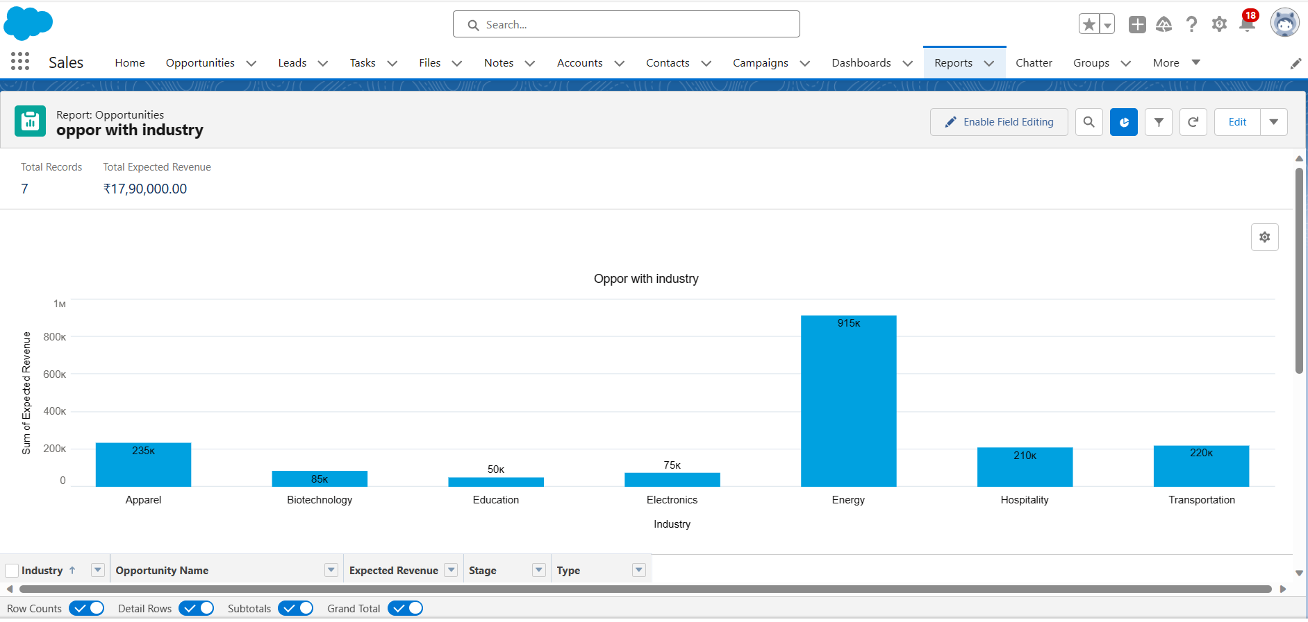
Task 6: Create Report Charts

Slide 16
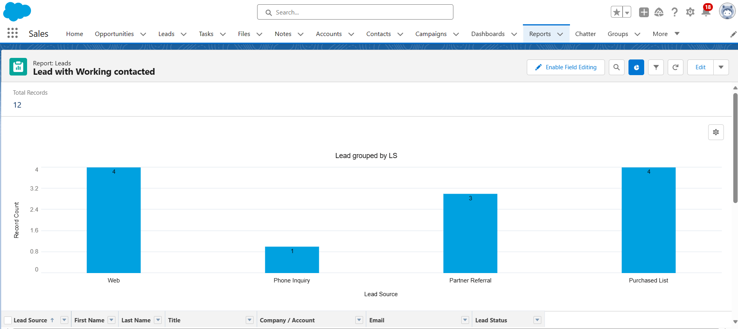
Task 6: Create Report Charts

Slide 17
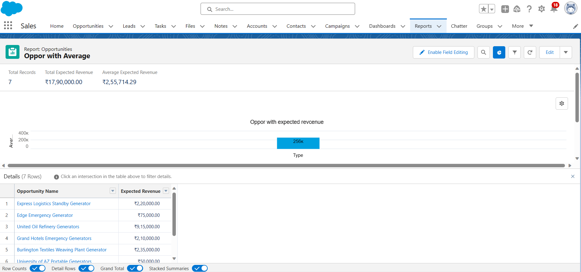
Task 6: Create Report Charts

Slide 18
Task 7: Create a Dashboard
On the following slide, insert a screenshot of the dashboard you just created.

Slide 19
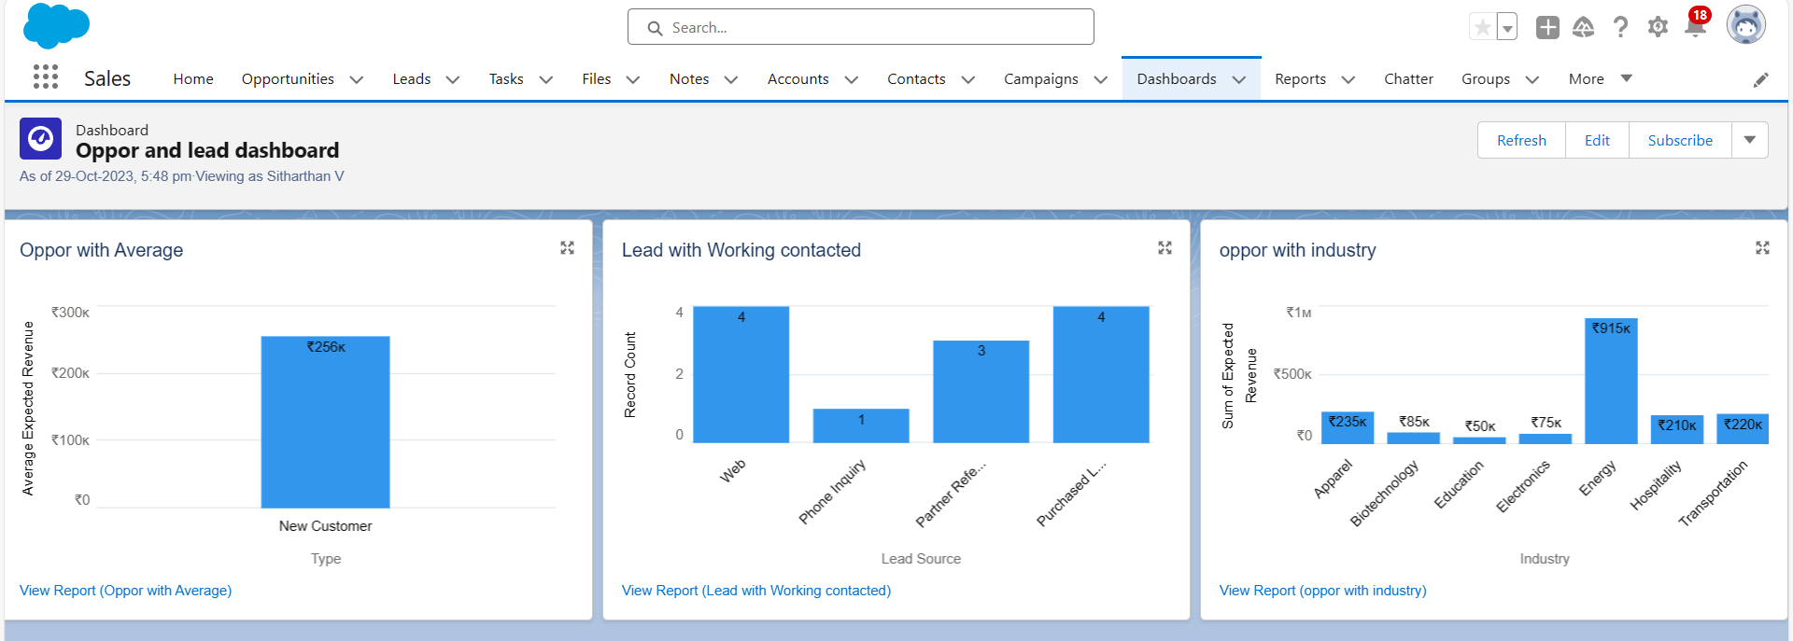
Task 7: Create a Dashboard

Slide 20

You have reached the end of this Project!
This is the end of this Independent Project! Great job completing all these tasks in Salesforce. Make sure you download a copy of this deck for your portfolio.

